Slide 1
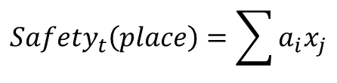
Time evolution of crimes in Chicago.
What are the safest places? And the most dangerous?
Here we establish a Safe/Non safe threshold, just as a first approach quantitative representation.
Weights for each crime type will be defined arbitrarily or backed by revelant studies in the field.
$${Safety}_{t}\left(place\right)=\sum{a_{i}x_{j}}$$

Slide 2
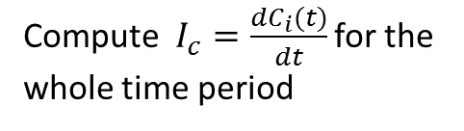

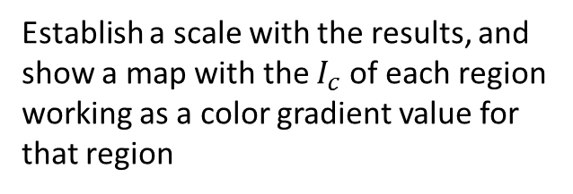
What regions saw the biggest decrease in criminality? Are they considered safe in 2017?
What regions saw the biggest increase in criminality? Are they considered dangerous in 2017?
$Let C_{i}\left(t\right)$ be the sum of crime i for time t
Compute $I_{c}=\frac{dC_{i}(t)}{dt}$ for the whole time period
Establish a scale with the results, and show a map with the $I_{c}$ of each region working as a color gradient value for that region

Slide 3
Ratio crime/arrest – This could give us an indicator of what the police/government/society(?) is more worried about and this could be a good approach to define weights for our Safety function.
However, this is not an unbiased indicator because some crime types are of a nature that enables a more efficient approach. (E.g. It’s much hard to avoid a homicide than to avoid a drug transaction.)
We could even compare the function outputs for government weights and studies’ weights.
Crimes have a monthly and seasonal trend. Is that interesting? Why?

